Slide 1
Cosmology Introduction to the Universe
Astro Ch. 11-1

Slide 2
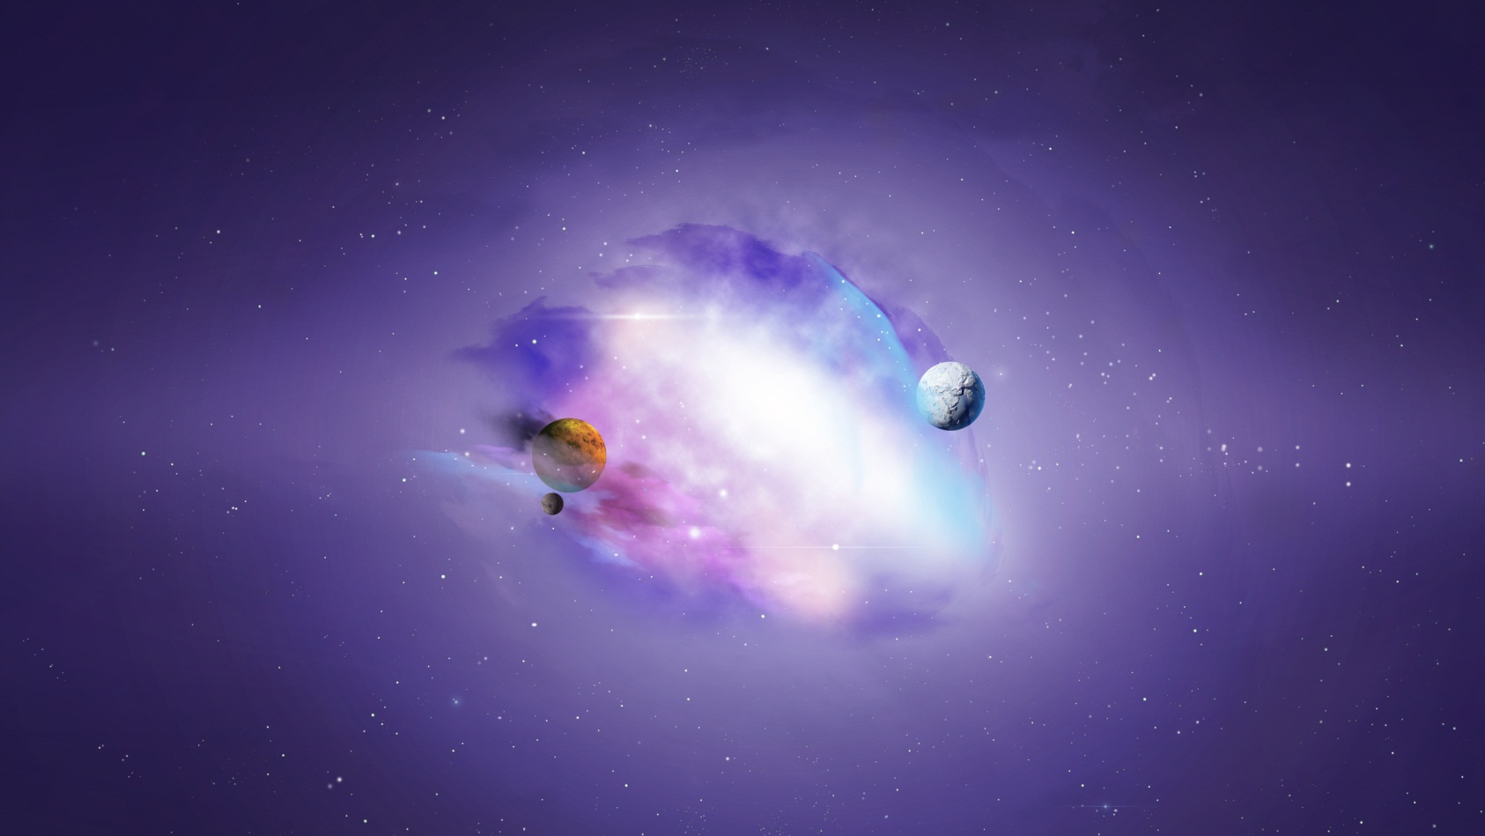
Cosmology
The study of the nature, origin, and evolution (how it changes) of the universe

Slide 3
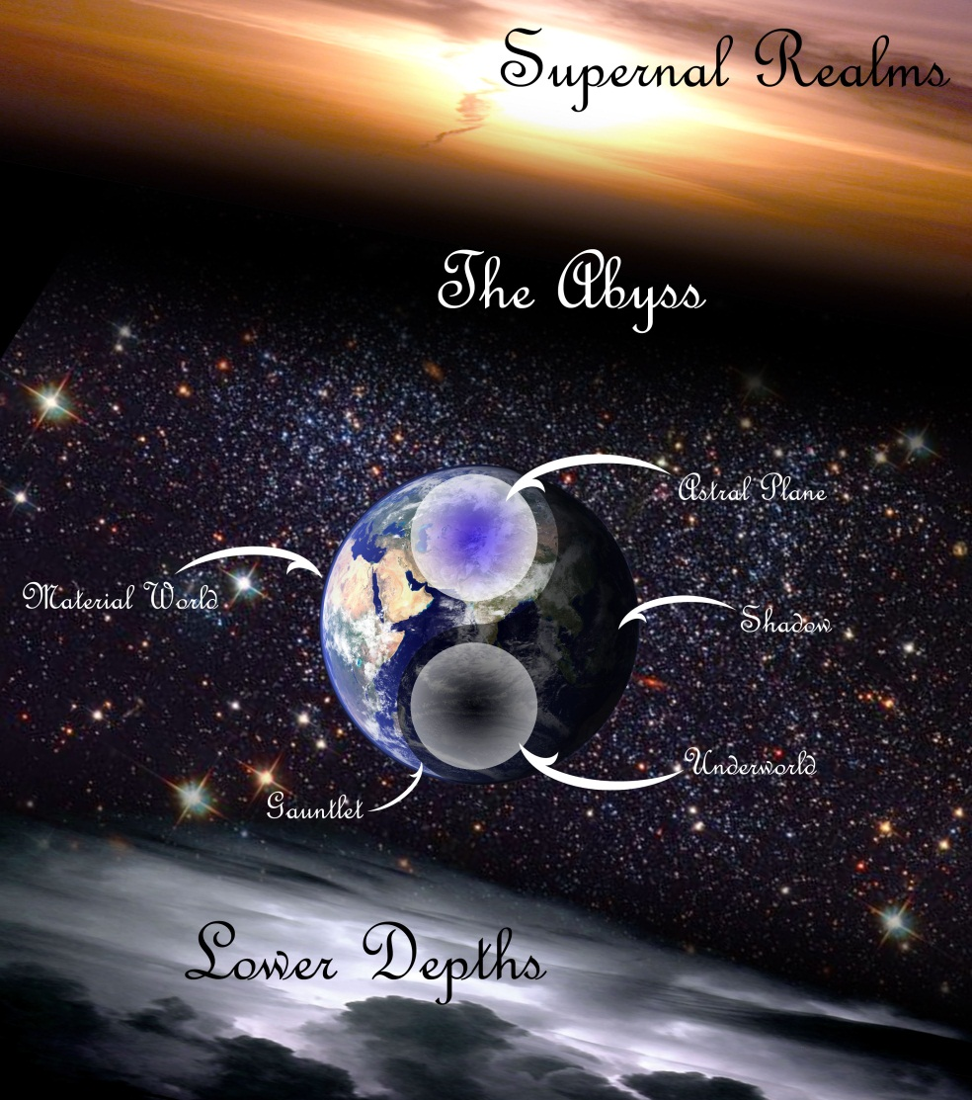
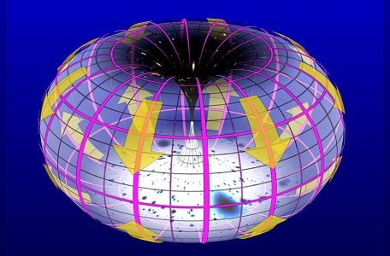
Basically the study of the universe as a whole
Cosmology is an attempt to understand how the universe works

Slide 4
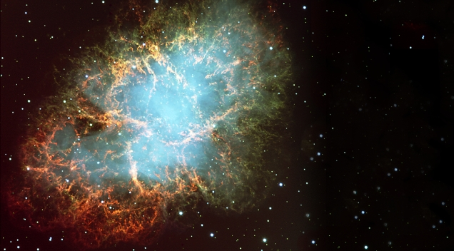
Universe
All the matter and energy that ever has, does, and will exist

Slide 5
Questions to consider, which may or may not be able to be answered.
→ What does the universe look like?
→ Is it a sphere?
→ What is outside the universe?
→ Is there an outside of the universe?
→ How old is the universe?
→ Where did the universe come from?
→ How did the universe begin, or is it eternal?
→ Where is the center of the universe?
→ Is there a center of the universe?

Slide 6
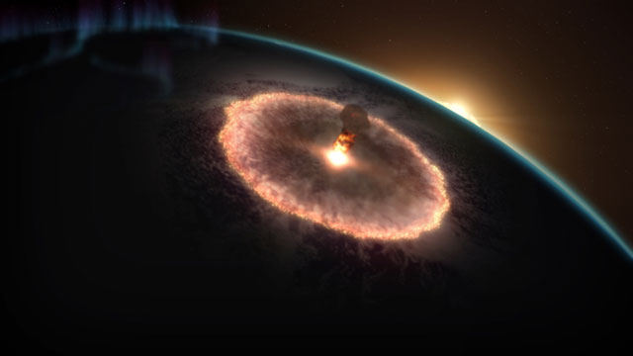
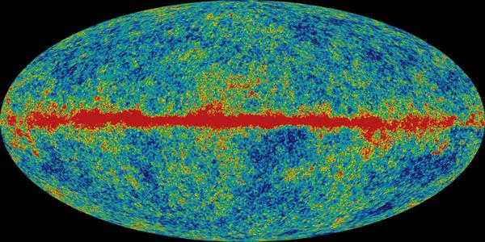
The Edge-Center Problem 2 Possibilities
1. Finite Universe
It is possible that there is an edge to the universe, making it finite
It could then be concluded that there would also be a center to the universe, which we could locate.

Slide 7
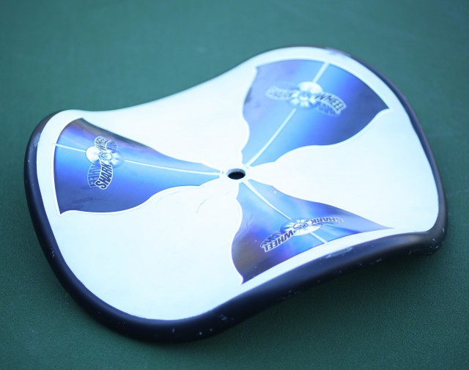
Generally you find the center of an object or space, by first defining the edges of the object or space.

Slide 8
If there is an edge…
→ What does it look like?
→ Is it some sort of barrier?
Would space, matter, energy, and time just
end at that point?
→ What would be outside this edge?
→ Could we see outside the edge?
→ How long did it take to get as old as it is?
→ Would time be finite as well?

Slide 9
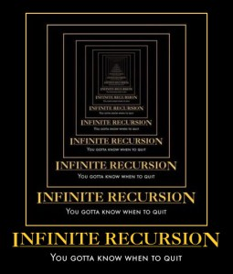
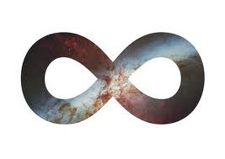
The Edge-Center Problem 2 Possibilities
2. Infinite Universe
It is possible that there is no edge of space, making space infinitely large.

Slide 10
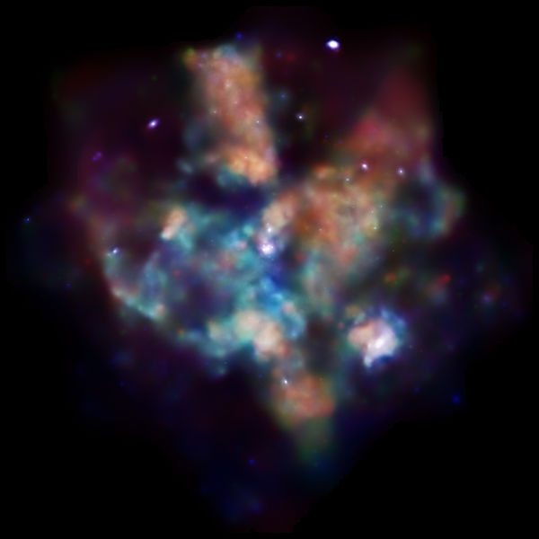
If there is no edge to the universe, then there would also be no center of the universe.
If there is no edge to the universe, then there would be no “outside” the universe.

Slide 11
If there is not an edge…
There is no sort of barrier, space just goes on
forever.
Would space, matter, energy, and time never
end at any point?
There is no center and finding our location in
the universe becomes impossible.
→ Is the universe also infinitely old?

Slide 12
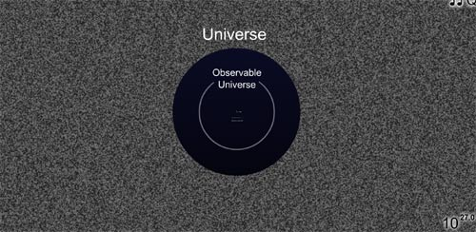
We can put a finite scale on a part of the universe.
Observable Universe – the part of the universe that you can see from your location
How much of the universe can we see?
Can we observe it all, or not?
Is it possible for us to see an edge if it exists?

Slide 13
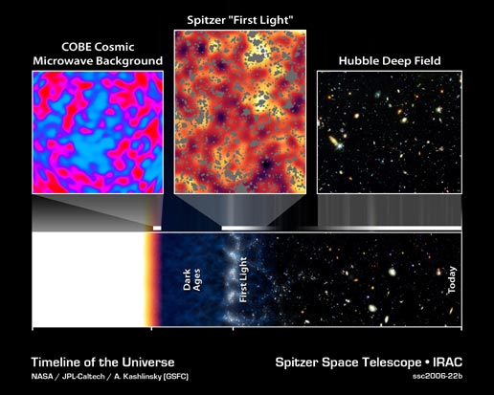
Was there a beginning of the universe, or is it eternal?
→ If there was a beginning, when was that, and
when will it end?
→ If the universe is eternally old, will it ever end?
→ Is time finite or infinite?

Slide 14
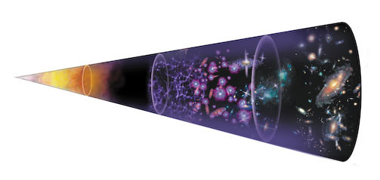
Hubble’s Red Shift statement in 1929 says that the universe is constantly expanding.
→ What is it expanding into?
→ Earth is clearly not at the center of the expansion.

Slide 15
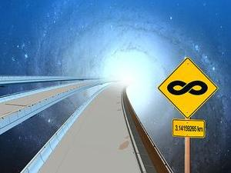
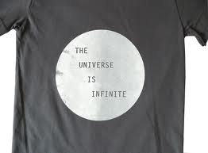
If the universe has no edge, and no center, but is expanding in all directions, there can be no size limit, and no one spot from which it is expanding.

Slide 16
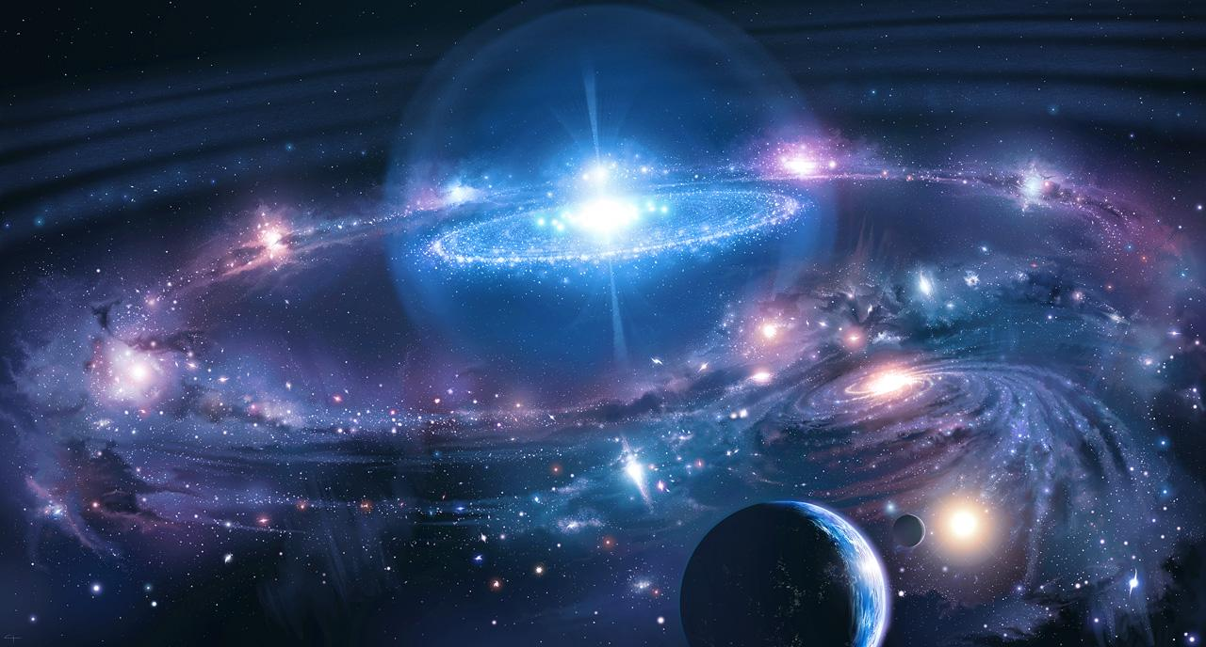
It is possible that the universe is larger than our human minds can comprehend.

Slide 17
It is also possible that the universe exists in ways that our human minds cannot comprehend.
→ Size
→ Multiple dimensions
→ Variable realms of existence
→ Types of existence and life forms
→ Variable times of existence in the same dimension
→ Perceptions
→ Existence outside of time
→ Existence without need of a physical form

Slide 18
Is there a way to ever figure out all these questions?
Humans have an innate need to understand our existence, so we will continue to try to figure it out.

